Slide 1








Front Foot Advantage
Why Early Bets on the WPL Will Redefine Global Brand Building
The Women's Premier League has become one of the world's most exciting and commercially
promising sports properties within just a few seasons.
Niranjan Gidwani
Certified Board Director (MCA - India) | Board Member | ESG Director | Digital Director | Fellow - Board Stewardship | Member UAE Superbrands Council | HBR Advisory Council
www.thoughtcollectiv.com

Slide 2
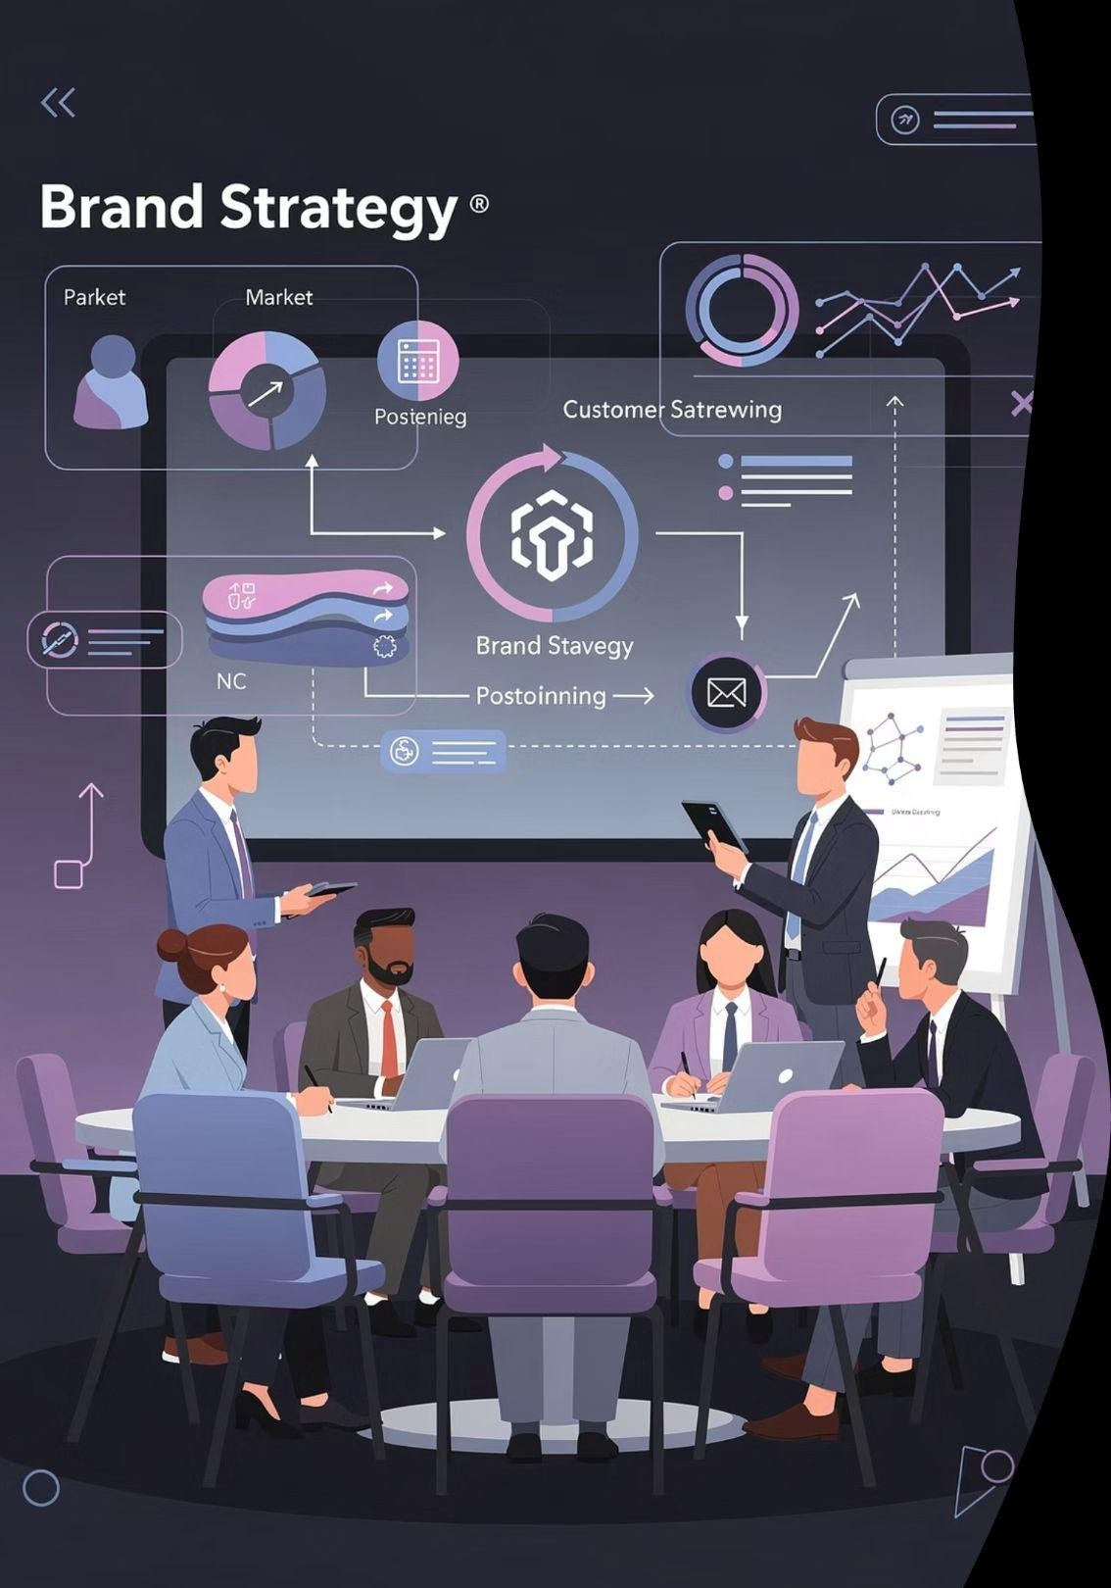


WPL: India's Biggest Emerging Consumer Touchpoint
Strategic Investment
Early sponsors like OpenAI (ChatGPT) are treating WPL as India's biggest emerging consumer touchpoint, not a side- bet on women's cricket.
Outsized Returns
WPL-first brands will enjoy exceptional returns in marketing, governance reputation and long-term strategic influence.
www.thoughtcollectiv.com

Slide 3

The WPL Phenomenon: Explosive Growth
GROWTH STORY
300M+
Total Viewers
WPL reached over 300 million viewers by 2025, up from 150
million in 2023
30M
Opening Matches
Single opening matches drawing around 30 million viewers on TV alone
140%+
YoY Growth
Year-on-year viewership growth on linear TV, making it one of India's fastest- scaling properties
Franchise sponsorship interest is now at an "inflection point", with teams expecting high double-digit revenue growth from brand partnerships.
www.thoughtcollectiv.com

Slide 4



Why Early Entrants Win Big
Buy Low Strategy
Entry pricing into women's sports properties tends to be materially lower than equivalent men's leagues, allowing early sponsors to "buy low" on an asset whose audience is compounding.
Lock In Leadership
As visibility, ratings and sponsor demand grow, renewals for early partners often lock in category leadership and preferential terms.
Narrative Advantage
First-mover brands become narratively entrenched as "the ones who believed early", which is difficult for later entrants to replicate at any price.
www.thoughtcollectiv.com

Slide 5

The OpenAI / ChatGPT WPL Bet
AI MEETS CRICKET
ChatGPT is a premier partner of the WPL for the 2026 and 2027 seasons, in a deal valued at around ₹48 crore, marking AI's first major foray into cricket sponsorship.
The association places a cutting-edge AI brand at the centre of India's
most emotionally charged cultural arena, which is cricket.
₹48Cr
This move extends OpenAI's India push from pure "code and developers" to mass consumer trust, recognition and everyday usage intent.
Deal Value
2026-2027 seasons
www.thoughtcollectiv.com

Slide 6

WPL as India's Biggest Emerging Touchpoint
National Language
Cricket is India's default national language. Inserting a brand into women's cricket places it inside family living rooms rather than just tech or business circles.
High-Frequency Exposure
WPL offers intense, high-frequency exposure across 3 to 4 weeks of prime-time fixtures annually, creating campaign-like continuity for sponsors.
Cross-Sector Validation
The league has already attracted 15+ major sponsors in 2026 spanning banking, FMCG, mobility, tech and consumer durables, showing broad market confidence.
www.thoughtcollectiv.com

Slide 7


Why Women + Sport Is Essential Now
NON-NEGOTIABLE
20%+ YoY Growth
Sponsorship deals across women's professional sports globally have grown more than 20% year-on- year, outpacing many traditional media properties.
Values-Driven Audiences
Women's sports audiences are seen as more progressive and values-driven, rewarding brands that visibly support equality and participation.
Strategic Imperative
Ignoring women's sports now signals strategic myopia in both marketing and ESG. Investors and boards are increasingly scrutinising gender-lens engagement.
www.thoughtcollectiv.com

Slide 8

India's Women: Aspiration, Not "Segment"
Changing Consumption Patterns
Rising female labour-force participation, higher
education levels and digital adoption are
transforming consumption patterns in Indian households.
Diverse Viewership
WPL viewership is increasingly diverse, with a fast-growing proportion of women watching other women play elite sport.
Primary Decision-Makers
Brands that treat Indian women as primary decision- makers, not peripheral influencers, will gain long-term loyalty and word-of-mouth advocacy.
www.thoughtcollectiv.com

Slide 9





Cricket as the Launchpad for All Women's Sport
Broadcaster Confidence
When broadcasters and sponsors see sustained returns from WPL, their risk appetite for other women's leagues increases.
Icon Development
Success stories in the WPL will build a bench of women athletes who can cross over as icons in multiple sports and social causes.
Normalisation
Cricket's cultural dominance means investments here normalise women's sport as "must-watch", making it easier to extend interest to football, kabaddi, athletics and more.
www.thoughtcollectiv.com

Slide 10


Stories: When Early Believers Changed the Game
CASE STUDIES
Glossier & WNBA
In the WNBA, Glossier became the first official beauty partner in 2020, winning outsized cultural relevance and consumer love for investing early in women's basketball.
NWSL Early Sponsors
In women's football, brands backing the NWSL before its current boom are now benefiting from record sponsor revenues and deep fan goodwill.
These cases show a pattern - the first visible sponsors of women's leagues become part of the sport's origin story, not just logo inventory.
www.thoughtcollectiv.com

Slide 11

WPL Team Owners & Long-Term Vision
Capri Sports (UP Warriorz)
Franchise owners report that central and team sponsorship revenues have hit an inflection point just a few seasons in.
Mumbai Indians
Established IPL brands see WPL as a strategic extension, expecting high double-digit sponsorship growth thanks to rising demand.
Patient Capital
This signals that powerful, patient capital sees WPL as a
multi-decade asset, not an experiment.
www.thoughtcollectiv.com

Slide 12

Commercial Flywheel: A Virtuous Cycle
Growing Audiences
Investment in Grassroots
Increased Rights & Sponsorship
As ratings and reach grow, media rights and sponsorship values increase, allowing more investment into grassroots, coaching and talent scouting. Better quality cricket and higher player remuneration create more compelling narratives, further pulling in casual viewers.
This virtuous cycle is still in early innings for WPL, so early brands are buying into the steepest part of the growth curve.
www.thoughtcollectiv.com

Slide 13
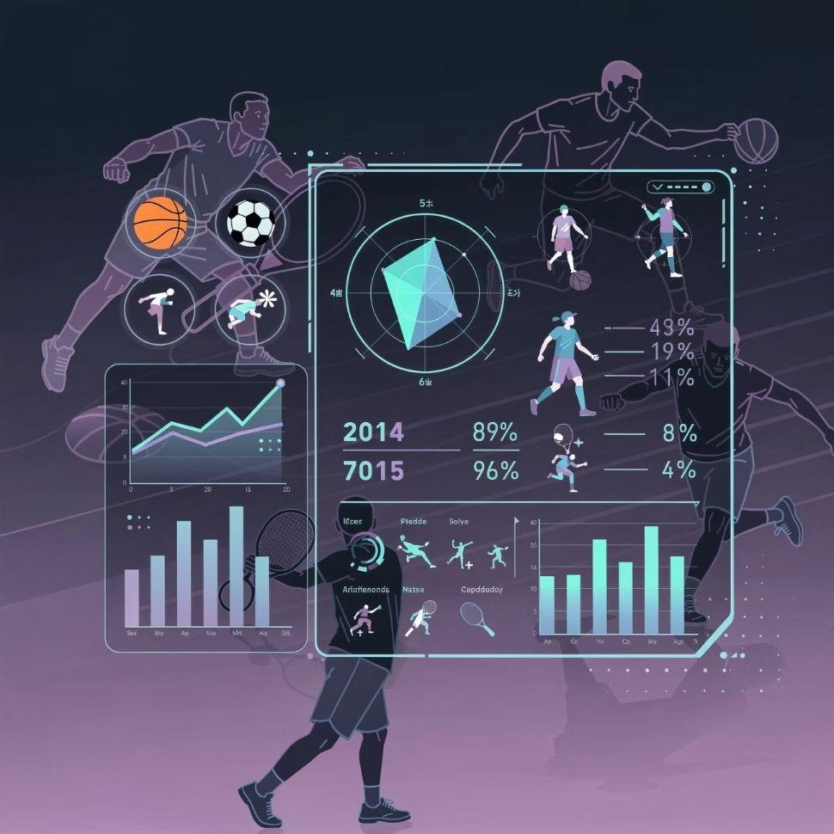
Technology Brands on the Front Foot
TECH LEADERSHIP
Proven Track Record
ChatGPT's WPL partnership follows its earlier sports-related activations with the New York Mets, San Antonio Spurs and Chip Ganassi Racing, where AI tools drove fan engagement and performance analytics.
Fertile Ground for AI
Sports ecosystems are fertile grounds for demonstrating AI use cases: personalised content, real-time stats, and conversational interfaces for fans.
Human Connection
By anchoring AI in a human, emotional context like women's cricket, tech brands can escape being seen as abstract utilities and instead become relatable companions.
www.thoughtcollectiv.com

Slide 14

Brand Architecture: From "Sponsor" to "Ally"
01 02
Position as Allies
The most successful women's sport sponsors position themselves as allies in talent development, equality and access, not just 30-second ad buyers.
03
Authentic Storytelling
Campaigns that feature real athletes' journeys, vulnerabilities and triumphs generate higher engagement than generic celebrity endorsements.
Meaningful Narratives
For a brand like ChatGPT, this opens space to tell stories around learning, resilience and problem-solving through the lens of women cricketers.
www.thoughtcollectiv.com

Slide 15
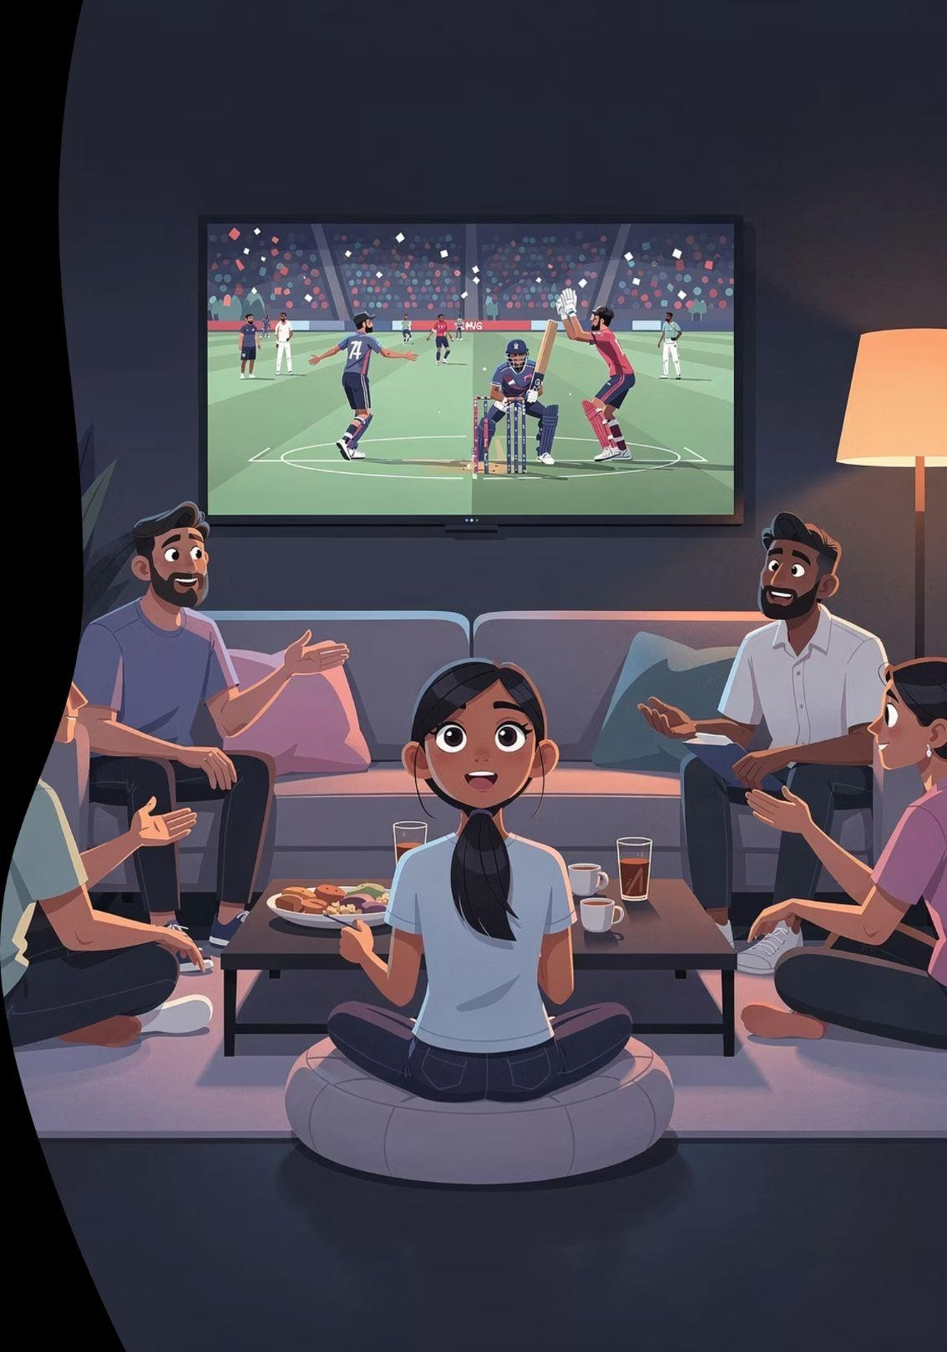



Why This Matters So Much to Indian Women
Shifting Possibilities
Young girls in India are seeing full stadiums, prime- time slots and significant prize money for women cricketers, fundamentally shifting what feels possible as a career.
Household Conversations
Household conversations change when fathers, mothers, sons and daughters sit together to watch women's matches as appointment viewing.
Spillover Benefits
This visibility has spillover benefits into workplace aspirations, educational choices and leadership ambitions for women well beyond sport.
www.thoughtcollectiv.com

Slide 16

Lessons for Marketing Leaders
FOR CMOS
1
Strategic Platforms, Not CSR
Treat women's leagues as strategic platforms, not CSR. Allocate core brand budgets, best creative
talent and long-term measurement frameworks.
2
Talk to Entire Families
Design campaigns that talk to entire families and communities, not only "female consumers", recognising how viewing is social in India.
3
Build Integrated Journeys
Build integrated journeys where exposure in matches leads to app usage, trials, subscriptions
or product experiences linked to the league.
www.thoughtcollectiv.com

Slide 17
FOR BOARDS
Lessons for Corporate Governance & Boards
Visible Indicator
Sponsoring women's sports is now a visible indicator of a board's stance on gender equity, talent development and inclusive growth.
ESG Integration
Boards can integrate women's sports engagement into ESG scorecards and stakeholder reports, making it part of long- term value creation, not side philanthropy.
Reputational Capital
Transparent, multi-year commitments (vs. one-off deals) demonstrate stewardship. Standing by leagues through early volatility builds reputational capital.
www.thoughtcollectiv.com

Slide 18

Risk, Return and Stewardship Mindset
Investor Alignment
This aligns with how sophisticated investors view emerging assets: Enter early, build capabilities, and ride compounding growth rather than overpay later.
Asymmetric Upside
Early WPL sponsorship carries execution risk (format evolution, scheduling, initial ratings uncertainty) but offers asymmetric brand upside as the league matures.
Long-Term Thinking
A stewardship mindset means accepting near-term complexity for long-term category leadership and social impact.
www.thoughtcollectiv.com

Slide 19

India's Broader Women's Sports Wave
ICC Success
India's ICC Women's World Cup success and global performances have turbocharged interest in women's cricket and boosted trust in WPL's competitive quality.
Future Positioning
By being visible in WPL today, brands are well- positioned to scale into the next generation of women's leagues as they emerge.
1
2
3
Ripple Effect
Success in one marquee sport often leads federations and broadcasters to experiment more with women's football, hockey and athletics properties.
Niranjan Gidwani
www.thoughtcollectiv.com

Slide 20




What the Future Could Look Like
FUTURE VISION
Global Hub
WPL could evolve into a global hub for women's T20 talent, attracting players, coaches and audiences from multiple cricketing nations.
AI-Infused Experiences
AI-infused fan experiences (chat assistants, vernacular explainers, personalised highlight reels) can become standard for sports consumption in India.
Ecosystem Architects
In such a future, early WPL sponsors will be seen as architects of a new sports-tech-media ecosystem rather than mere advertisers.
www.thoughtcollectiv.com

Slide 21
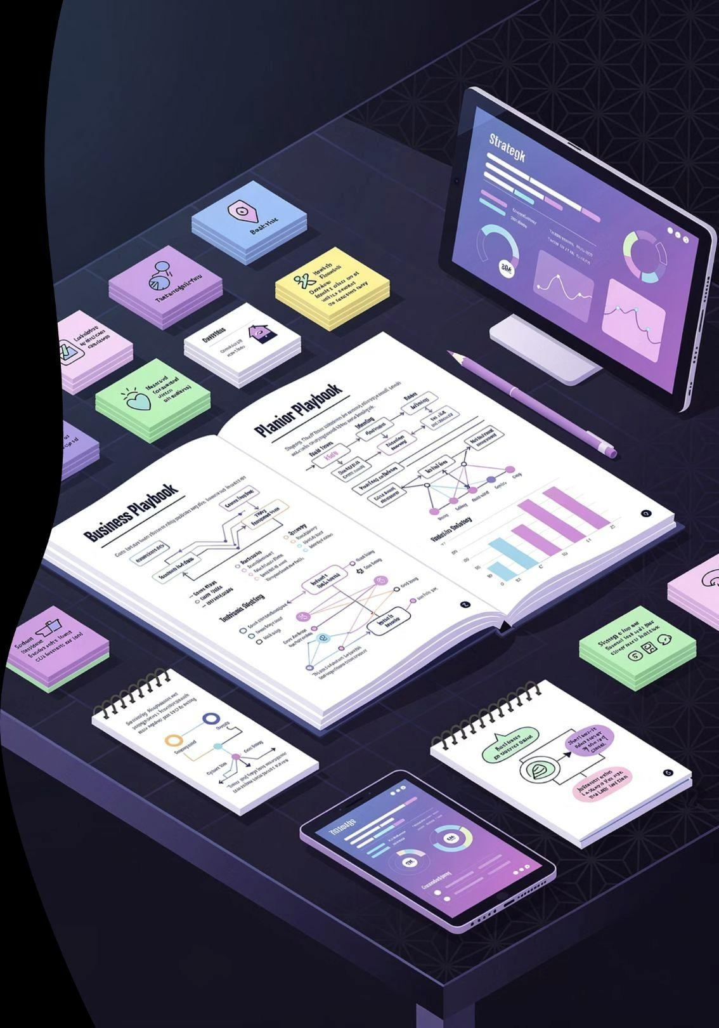
Strategic Playbook for Early Entrants
Long-Term Commitment
Commit for at least 3–5 seasons to signal seriousness and capture compounding awareness as the league scales.
Layered Storytelling
Build layered storytelling: grassroots activation, academy partnerships, player content, and fan tools that go beyond on-screen logos.
1
2
Inclusive Innovation
Use WPL as a testbed for inclusive product design and communication, drawing insights from women fans and athletes into the core business.
3
www.thoughtcollectiv.com

Slide 22

For Boards and CMOs
KEY TAKEAWAYS
1
2
3
Strategic Lever
WPL is not just a sports property. It is a strategic lever for gender equity, youth engagement and digital experimentation at national scale.
Shape the Culture
Early association enables brands to shape league culture, fan expectations and technology integration in ways late entrants cannot.
Window of Opportunity
For India-focused and global brands alike, missing this window may mean forfeiting a generation of trust with women and young fans.
www.thoughtcollectiv.com

Slide 23

Own the Narrative
"Those who stand with women when the stands are still filling will own the narrative when the stadiums are full.
In betting on the WPL today, brands are not only buying media. They are underwriting a new social contract between business, sport and half of humanity."
www.thoughtcollectiv.com

